Slide 1
Development of Expertise
Presentation and its Impact on Learners

Slide 2

Learning Computer Science
When learning new concepts in CS, students…
Must deal with language and API syntax
Will work in new semantic structures
May have preconceived notions and perceptions
Develop expertise through a series of cognitive stages
When teaching in CS courses, our goal is to help students wrestle with these challenges while developing expertise.

Slide 3
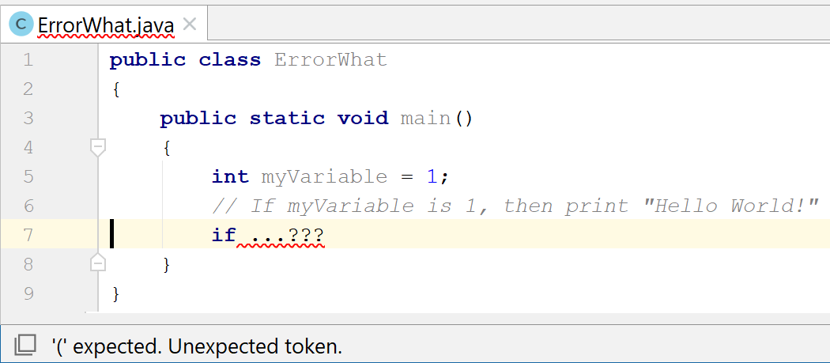
Language Challenges – Syntax
Can increase logic error rates [McIver and Conway]
Contributes to learning barriers [Ko et al]
Notes:
Text languages, which are commonplace in industry and college education, present challenges to the novice programmer with respect to syntax and semantics.
-McIver and Conway developed GRAIL language in an attempt to minimize syntax errors; found that students using GRAIL had lower number of syntax errors, also a lower number of logic errors, suggesting that students who face fewer syntax challenges can reduce their logical errors as a result.
Ko et al. identified syntax as a contributing factor in some learning barriers;
use barriers (how to employ the construct) – even if a user knows that an “if” statement provides conditional execution, they may not be able to properly construct the conditional expression.
selection barriers (identifying the right interface for a task)—such as when a user knows what task to accomplish, but can’t determine (select) the correct construct. For example, a user in a simulation environment may know that a task requires moving a character to a particular location on the screen but may have difficulty identifying which syntax will accomplish that goal.

Slide 4

Language Challenges – Semantics
Requires understanding overall context
Chunking, abstraction reduce cognitive load
Contribute to use and selection barriers
Impact on tracing & debugging
Notes:
Each programming language construct has specific semantics – the meaning of the construct. You have to understand syntax, but also context of section of code.
-Students in the early stages of dev see lines of code as individual elements, rather than as abstract chunks, increasing cognitive load, limiting abstraction
-Programmers at concrete and formal operational stages of reasoning development perceive text as a composition of constructs using an internal mental models; they chunk out blocks of code and summarize their meaning.
-Ko noted that semantics were a key aspect of use barriers (prev) and coordination barriers (misunderstanding how constructs interact with one another
-Semantics also play a critical role in debugging, as practitioners must read, trace, and develop abstract models of sections code
Taken together, syntax and semantic challenges represent a potentially significant hurdle for students to overcome.

Slide 5


Language Challenges - Perceptions
Text languages can be intimidating
Association with “uninteresting” tasks
Notes:
Text-based languages, especially production languages, have been noted as presenting perception-based challenges;
-Text-based languages can be intimidating, especially for women -Begel and Klopfer, in developing StarLogo TNG, found that women and girls (focus groups) felt intimidated by (text-based) programming languages, viewed them as male-oriented -Association with uninteresting / boring / “uncool” work tasks has also been implicated in limiting motivation among students in minority populations (DiSalvo, minority populations). Visual languages attempt to address many of these issues by making the environments more inviting and approachable and by incorporating games, simulation, and multimedia [4, 37, 38].

Slide 6
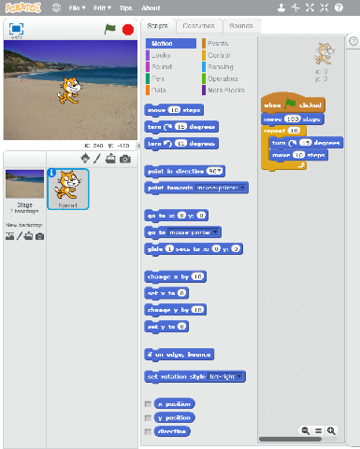
Blocks-Based Programming Environments
Approach
Eliminate syntax errors
Sensory affordances
Shapes, colors, connectors
Snap together on connection
Multimedia environments
Efficacy
Help students learn to program
Issues in confidence, authenticity (Weintrop, 2016)
Scratch – scratch.mit.edu
Notes:
Blocks-based environments attempt to address many of these issues by providing affordances while being approachable and incorporating interesting tasks.
-Eliminate syntax issues (impossible) -Sensory affordances: constructs have different shapes / colors / puzzle piece connectors (Scratch, MIT Media Lab, led my Mitchell Resnick); also snap together when connected correctly to indicate such
-Built as multimedia env allowing simulations and other engaging tasks to be accomplished
-Can help students learn to program
-However, Weintrop’s work with high school students working in blocks and text showed a dip in confidence when switching and perceptions of blocks as inauthentic; my work has shown negative perceptions of text in same context; may be related to absence of affordances
(1:20)

Slide 7
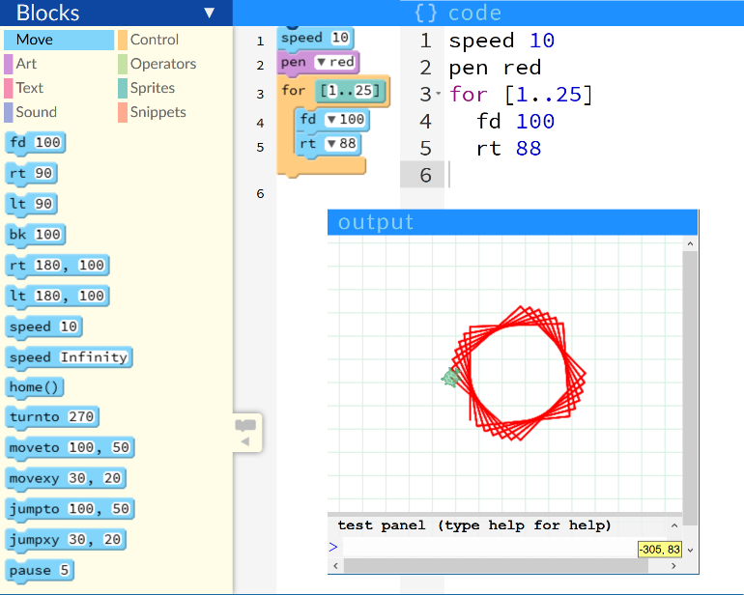
Hybrid Environments
Multiple representations
Can go between representations
Some are bi-directional (Bau, 2015)
Affordances of blocks
Authenticity of text
Blocking / chunking
Pencil Code – pencilcode.net
Notes:
-Hybrid environments try to take the best of both worlds
---Multiple representations of the same code
---and allowing users to go between representations
---Some, like David Bau’s Pencil Code, are bidirectional – blocks to text and vice versa –transition at own pace
---Blocks for the affordances and scaffolding of blocks-based environments
---Offer authenticity of text in text mode
---In Pencil Code, show not just blocks but text overlaid on blocks; explicitly connects constructs to their representations in text & syntax, showing equivalence of reps
---May provide scaffolding for students to develop skills in chunking and abstraction by visually delineating text elements that represent a construct
(1:05)

Slide 8
Neo-Piagetian Framework
Based on Piagetian Model
Expertise helps cope with limited working memory
Depends on chunking and abstraction
Sensori-Motor
Pre-Operational
Concrete Operational
Formal Operational
Notes:
-Early attempts to understand development of programming skills followed the constructivist / Piagetian tradition.
-In this framework, students learn by construct their own knowledge via assimilation (bringing new information into existing frameworks) and accommodation (reframing mental representation to match new experiences).
-Piagetian framework is closely tied to mental development and age-based maturity [40].
-Sensorimotor stage encompasses infancy (through age of 2) and is characterized by a lack of internalized thinking -Pre-operational stage is described as intuitive (rather than logical) and lasts until the age of 7. -Concrete operational stage (through age 11), children apply logic, but only to their concrete inputs -Formal operational stage (from age 11), children can reason fully in the abstract. Lister instead proposed applying the Neo-Piagetian framework – which decouples age and maturity from development of skills – to account for cognitive development in the domain of programming. This model is supported by empirical evidence from Corney et al [41] and think aloud studies by Teague et al [42]. In this section I briefly summarize each stage as it relates to programming skill development. -Humans have limited capacity in their short-term or working memory, as argued by Miller in 1956 [43].
-In order to cope with these limitations, experts employ chunking as a mechanism to recall information and ideas [44].
-Information is broken into chunks which are stored in long-term memory; these chunks can be recalled as a single concept in working memory, reducing the number of unique ideas that must be in the working memory at a particular moment in time, and thereby reducing cognitive load [44].
-As such, the development of chunking and abstraction methods is tied intimately with the evolution of advanced stages in the Neo-Piagetian model of development.

Slide 9

Neo-Piagetian Stages
Sensorimotor
Know code produces a result
Don’t see program as sequence of instructions
Lack understanding of constructs
 | Sensori-Motor | Pre-Operational | Concrete Operational | Formal Operational
Know that code produces a result
See program as sequence of instructions
Understand individual lines of code
Can read / trace code with some accuracy (50%+)
Reason abstractly about familiar situations
Reason abstractly about unfamiliar situations
✔️
Notes:
Lister proposed four stages of reasoning development in programming within this framework: -In the sensorimotor stage, students see programming as a “black box” – they know the code produces a result but do not see the executing program as a sequence of instructions on a machine.
-They lack conceptual understanding of constructs and programs, even at a definitional level.
-Lister (and later Corney et al) identified students in this stage as those who could not read code and trace its execution with at least 50% accuracy [2, 41].
-Students in this stage, lacking an understanding of the constructs themselves, are unable to engage in abstraction. -Students in the pre-operational stage understand the function of individual lines of code. -They understand the deterministic nature of computer programs functionally and conceptually – that is, they understand the definition of constructs -but often cannot summarize sections of code to determine overall meaning or function. -According to Lister’s model [2], these students can accurately read code and trace its execution with at least 50% accuracy but struggle to relate the function of lines of codes with respect to one another, to explain what a section of code does, or to develop diagrams describing the function of code. -They may be able to write simple programs but cannot meaningfully think abstractly about programs.

Slide 10

Neo-Piagetian Stages
Pre-Operational
Program is a sequence of instructions
Understand lines of code (definitions)
Can trace code with some accuracy (50%)
Can’t summarize sections of code/ think abstractly
 | Sensori-Motor | Pre-Operational | Concrete Operational | Formal Operational
Know that code produces a result | ✔️ | ✔️
See program as sequence of instructions
Understand individual lines of code
Can read / trace code with some accuracy (50%+)
Reason abstractly about familiar situations
Reason abstractly about unfamiliar situations
✔️
✔️
✔️
Notes:
Lister proposed four stages of reasoning development in programming within this framework: -In the sensorimotor stage, students see programming as a “black box” – they know the code produces a result but do not see the executing program as a sequence of instructions on a machine.
-They lack conceptual understanding of constructs and programs, even at a definitional level.
-Lister (and later Corney et al) identified students in this stage as those who could not read code and trace its execution with at least 50% accuracy [2, 41].
-Students in this stage, lacking an understanding of the constructs themselves, are unable to engage in abstraction. -Students in the pre-operational stage understand the function of individual lines of code. -They understand the deterministic nature of computer programs functionally and conceptually – that is, they understand the definition of constructs -but often cannot summarize sections of code to determine overall meaning or function. -According to Lister’s model [2], these students can accurately read code and trace its execution with at least 50% accuracy but struggle to relate the function of lines of codes with respect to one another, to explain what a section of code does, or to develop diagrams describing the function of code. -They may be able to write simple programs but cannot meaningfully think abstractly about programs.

Slide 11

Neo-Piagetian Stages
Concrete-Operational
Can read, trace, and write code
Can think abstractly in familiar situations
Cannot apply abstractions to new / unrelated tasks
 | Sensori-Motor | Pre-Operational | Concrete Operational | Formal Operational
Know that code produces a result | ✔️ | ✔️ | ✔️
See program as sequence of instructions |  | ✔️ | ✔️
Understand individual lines of code |  | ✔️ | ✔️
Can read / trace code with some accuracy (50%+) |  | ✔️ | ✔️
Reason abstractly about familiar situations
Reason abstractly about unfamiliar situations
✔️
Notes:
Concrete operational reasoning requires abstraction and understanding the meaning of sections of code as they relate to concrete and familiar situations
-Students in this stage of development can read, trace, and write code.
-They can also engage in abstract thinking about programs, explain blocks of code, and draw diagrams describing code
-Are restricted to those situations with which they have experience – they typically cannot abstract away solutions and apply them to distantly related problems – i.e., apply them to a new task -McCracken working group identified abstraction as a key challenge students continue to struggle with at the end of most introductory computer science (CS1) courses [45]. -Being able to break code into sections, and then evaluate the function of that code as a whole – rather than merely tracing code execution – is a fundamental distinction between pre-operational and concrete operational development stages. This chunking mechanism facilitates abstraction of code into ideas that do not require line-by-line tracing [2]. Lister also argued that students in this stage understand three key properties – reversing, conservation, and transitive inference [2]:
reversing – computational operations can be “undone”; e.g. after shifting items in a list to the left, the operation can be reserved by shifting the same items in the list to the right.
conservation – equivalence of code across transformations that maintain the specification (targeted task); e.g., equivalence of two programs that find a minimum value in a set of values.
transitive inference – relationships in data (often math); e.g., if a program organizes data to guarantee that x > y, and separately that y > z, then it also organizes the data such that x > z.

Slide 12

Neo-Piagetian Stages
Formal Operational
“What computer programmers do”
Can reason abstractly about unfamiliar situations
 | Sensori-Motor | Pre-Operational | Concrete Operational | Formal Operational
Know that code produces a result | ✔️ | ✔️ | ✔️ | ✔️
See program as sequence of instructions |  | ✔️ | ✔️ | ✔️
Understand individual lines of code |  | ✔️ | ✔️ | ✔️
Can read / trace code with some accuracy (50%+) |  | ✔️ | ✔️ | ✔️
Reason abstractly about familiar situations |  |  | ✔️ | ✔️
Reason abstractly about unfamiliar situations
✔️
Notes:
-formal operational reasoning is“what competent programmers do, and what we’d like our students to do” (Corney et al). -Everything from concrete (read, trace, write, abstract), plus… -can reason abstractly about unfamiliar situations

Slide 13
Ok, so… How do I use this?
As we build experience for students, we should consider…
Syntax and semantic difficulties students face in new paradigms
The role perceptions (and stereotypes) play in technical learning
The capabilities of students at different stages of development
How to help students move from one stage to the next

